Slide 1



NH’S HOUSING SHORTAGE & ITS IMPACT ON EMPLOYERS
ROB DAPICE, Executive Director
Veteran Friendly Business Symposium
November 2023

Slide 2

We promote, finance, and support housing solutions for the people of NH.
Financed 1,800 units of multifamily rental housing
Monitored operations of thousands of units of rental housing we financed
Administered federally funded rental assistance for 9,000 households statewide
Helped 1,300+ families purchase a home

Slide 3
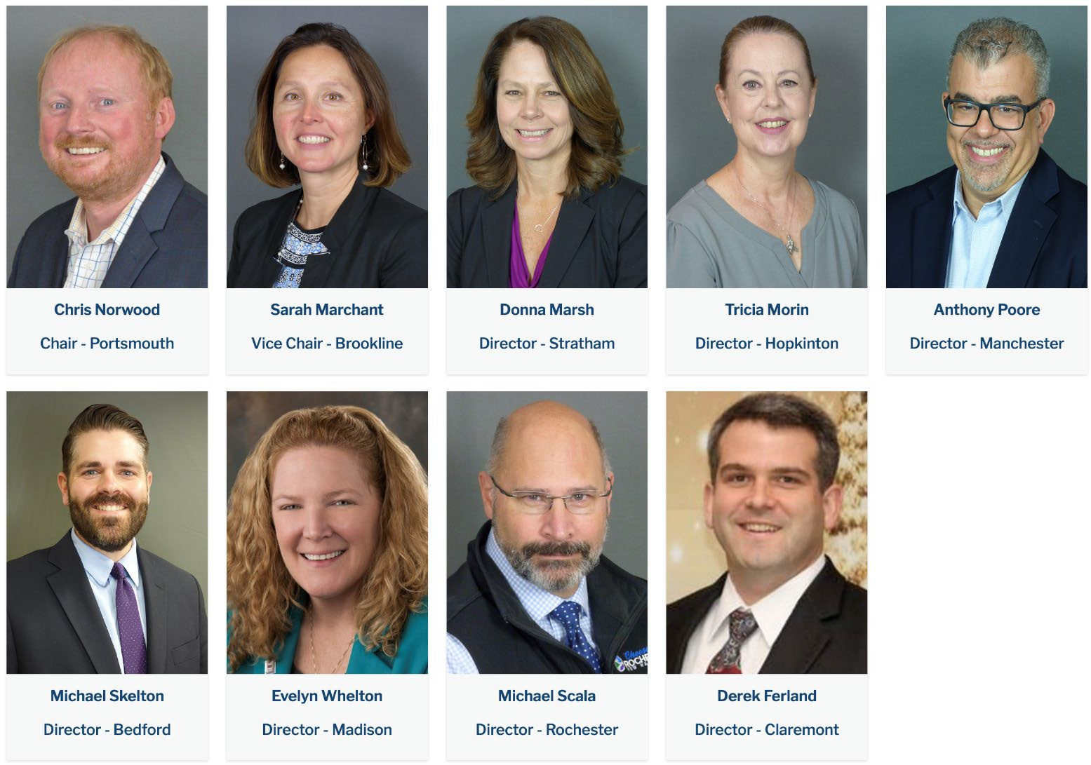
WHO WE ARE
Established in 1981 by state legislature as a self-sustaining public corporation
Not a state agency –
no state operating funds
Governed by a 9-member Board of Directors that is appointed by Governor and Council
NHHousing.org
|

Slide 4

OUR HOMEOWNERSHIP PROGRAMS
Unique Mortgage Programs
  Home First $10K downpayment assistance program
  1stGenHomeNH
Homebuyer Education
Grants to HOMEteam, AHEAD, Housing Partnership
Special Grants
Granite State Independent Living, Habitat for Humanity
NH Homeowner Assistance Fund Program
NHHousing.org
|

Slide 5
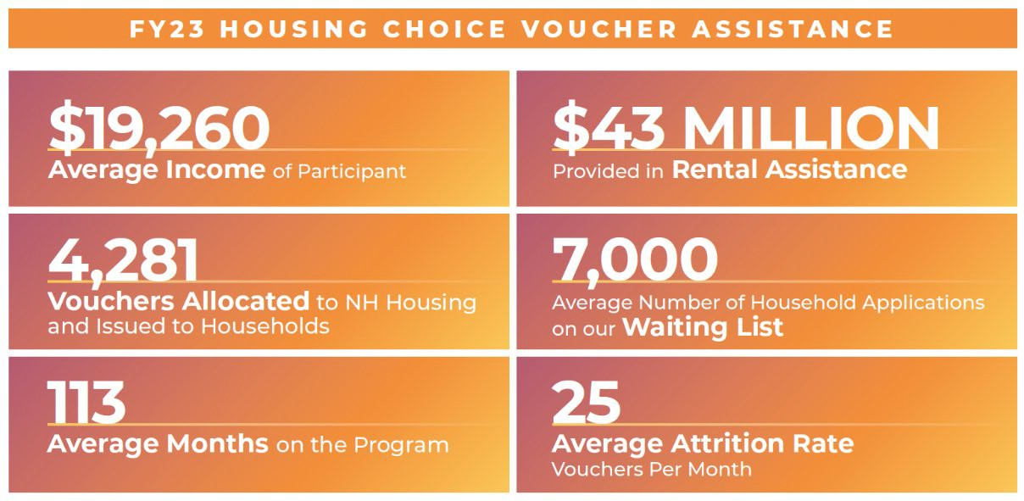

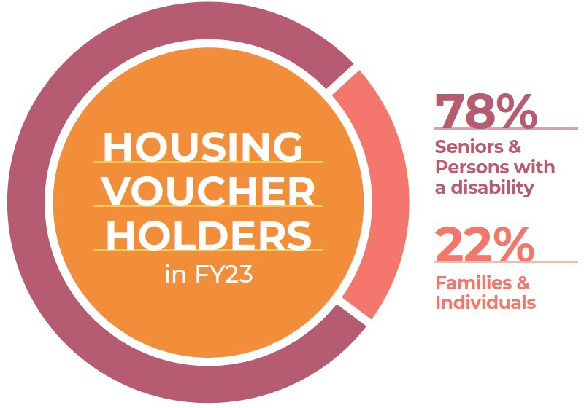
ASSISTED HOUSING DIVISION
Housing Choice Vouchers
(Section 8 vouchers)
Direct assistance to low-income households through HUD program
Other Assistance Programs
  Family Self-Sufficiency financial & employment coaching
  Voucher Assisted Mortgage Option
  Veterans Affairs Supportive Housing Vouchers
  Moving to Work Grants
  Landlord Incentives
NHHousing.org
|

Slide 6

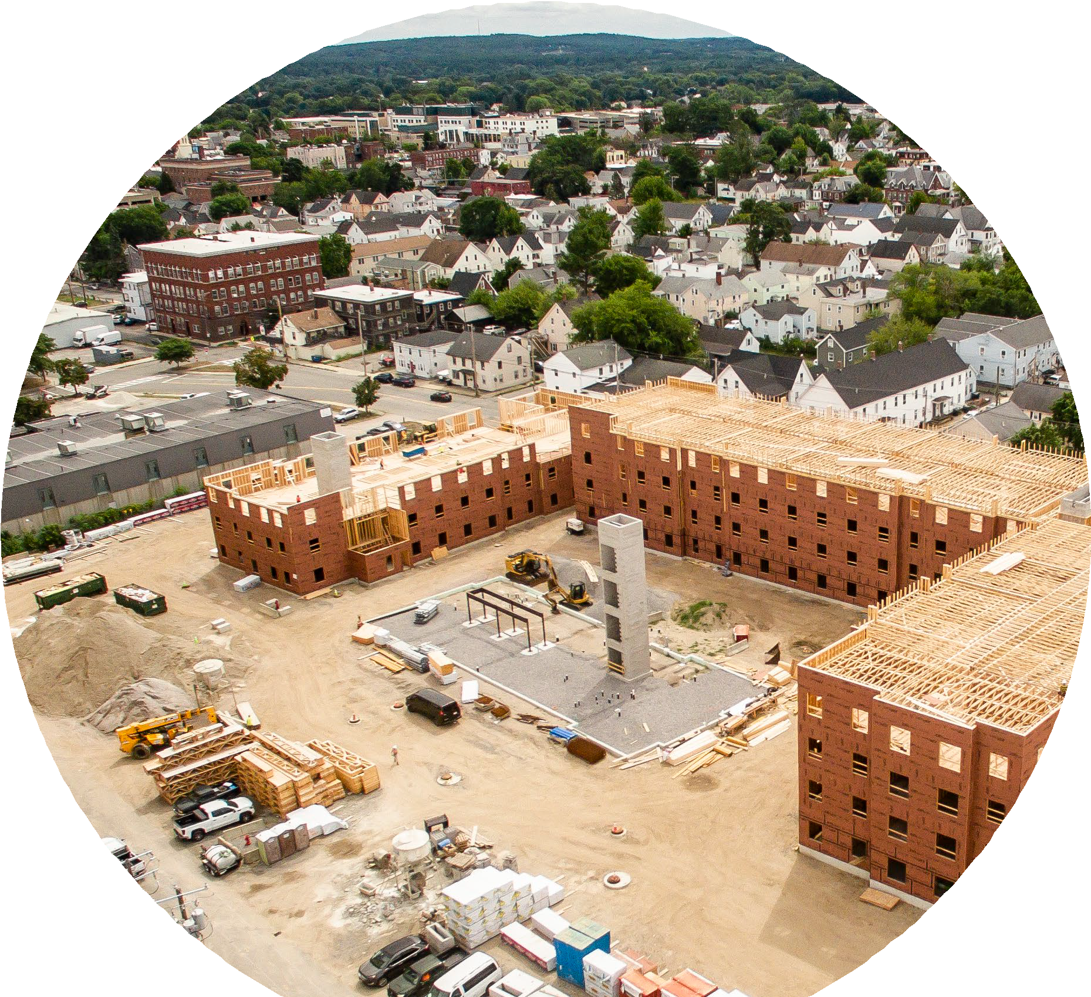

MULTIFAMILY HOUSING DIVISION
We finance construction, acquisition and preservation of affordable rental housing for families, individuals of all ages, and people who need supportive housing services (substance use disorders, veterans, transitional)
6

Slide 7


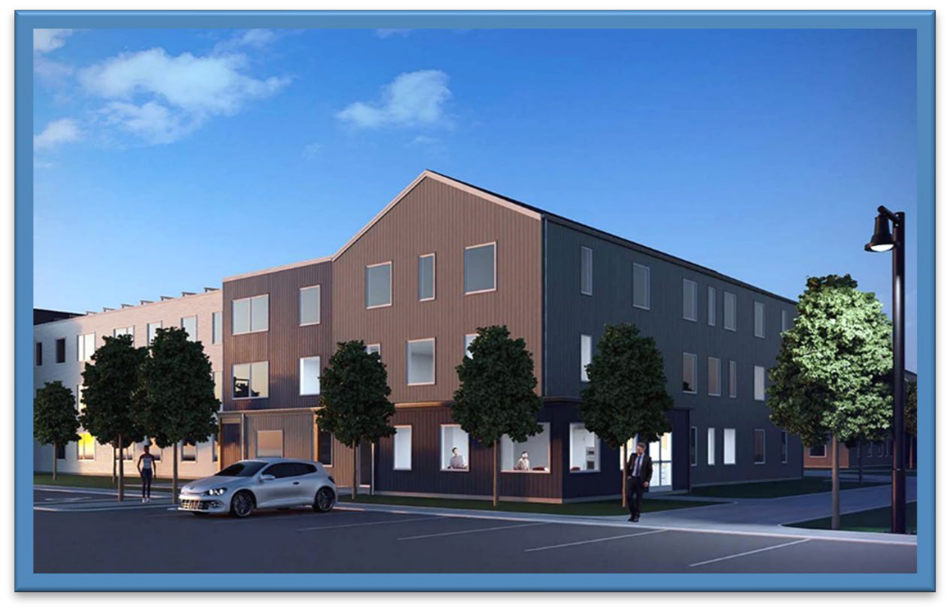
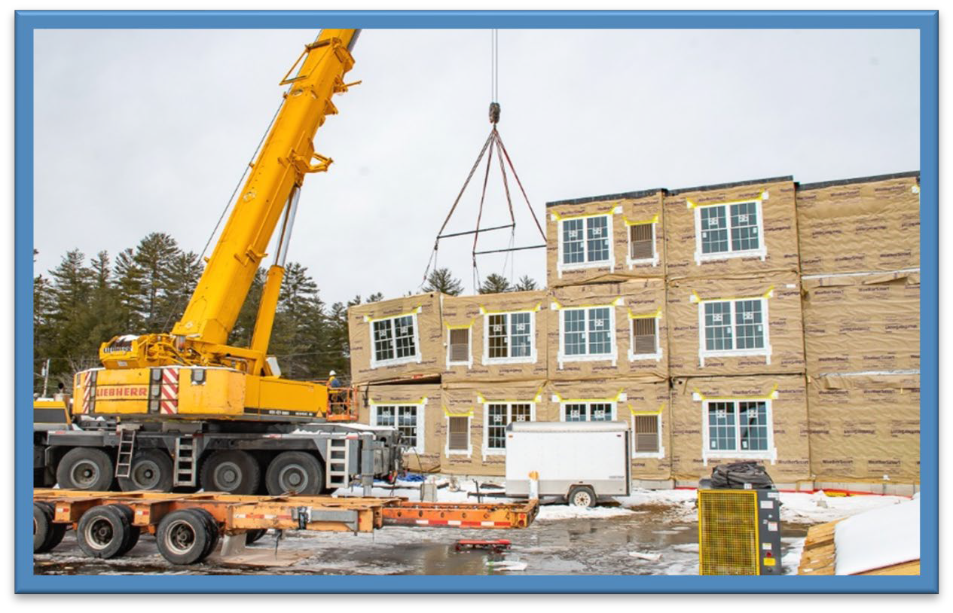
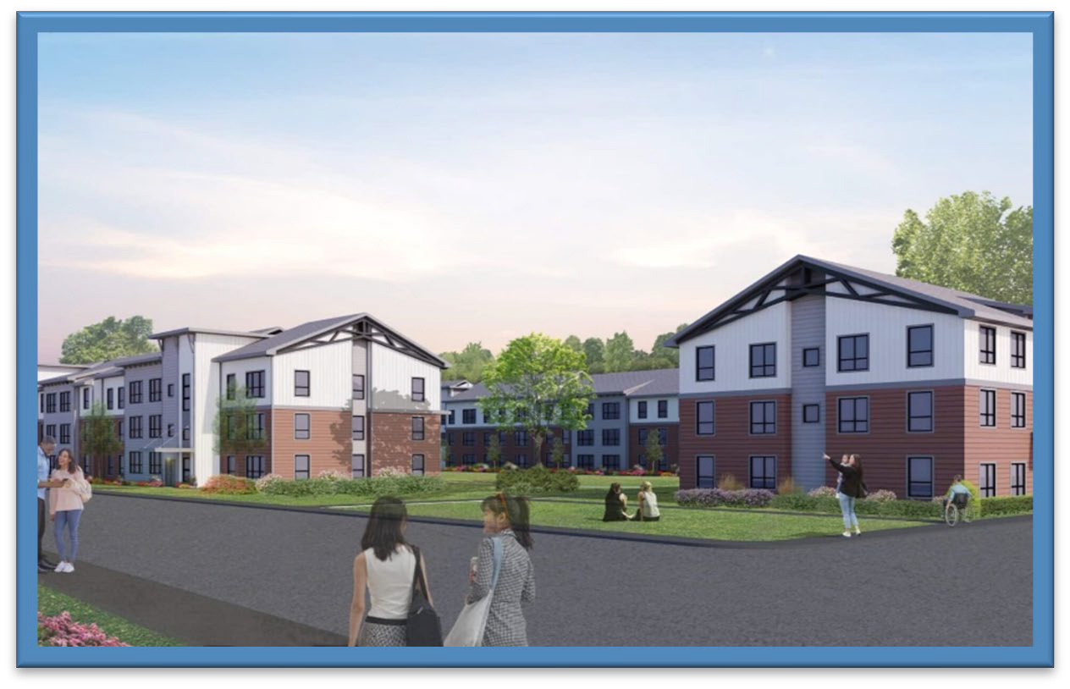
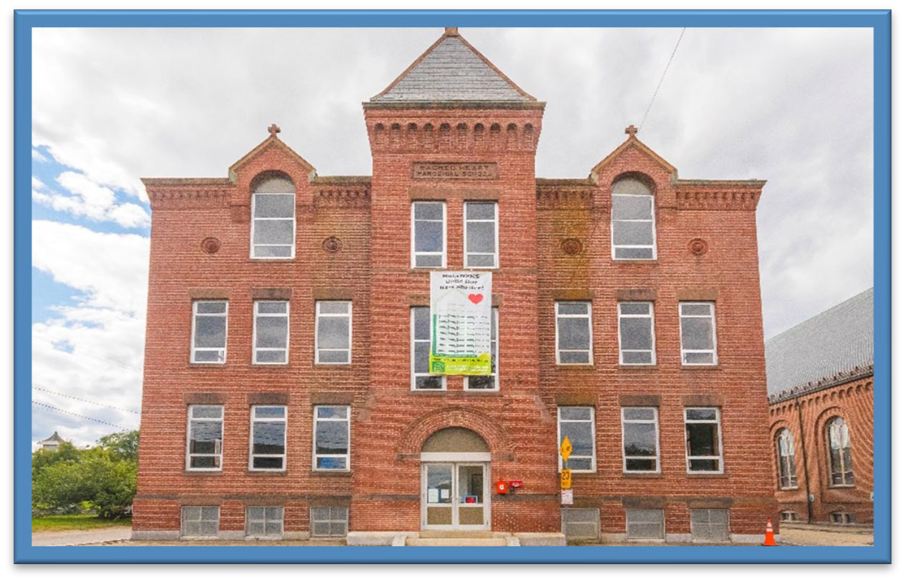
MULTIFAMILY FUNDING & DEVELOPER PARTNERS
River Turn Woods: Avesta Housing Development
The Rail Yard: Dakota Partners
Swanzey West: Avanru Development
Nashua Soup Kitchen & Shelter: Non-Profit, Supportive
CONWAY – River Turn Woods
40 units
SWANZEY – Swanzey West Apts.
84 units
CONCORD – The Rail Yard
96 units
NASHUA Soup Kitchen & Shelter 11 units
|

Slide 8
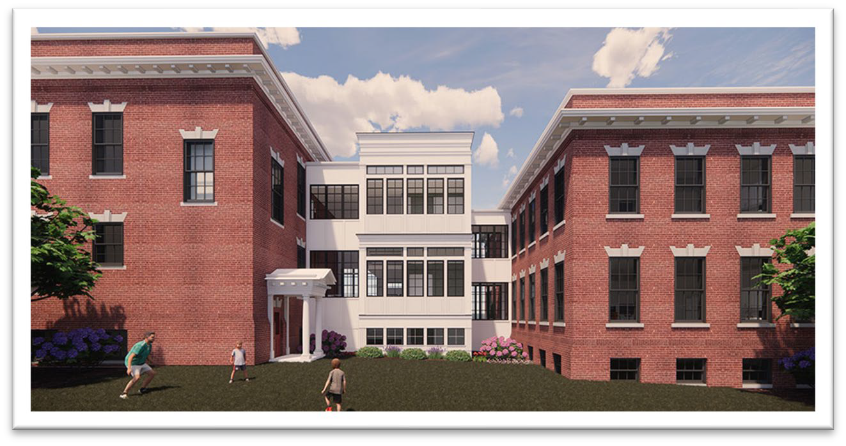
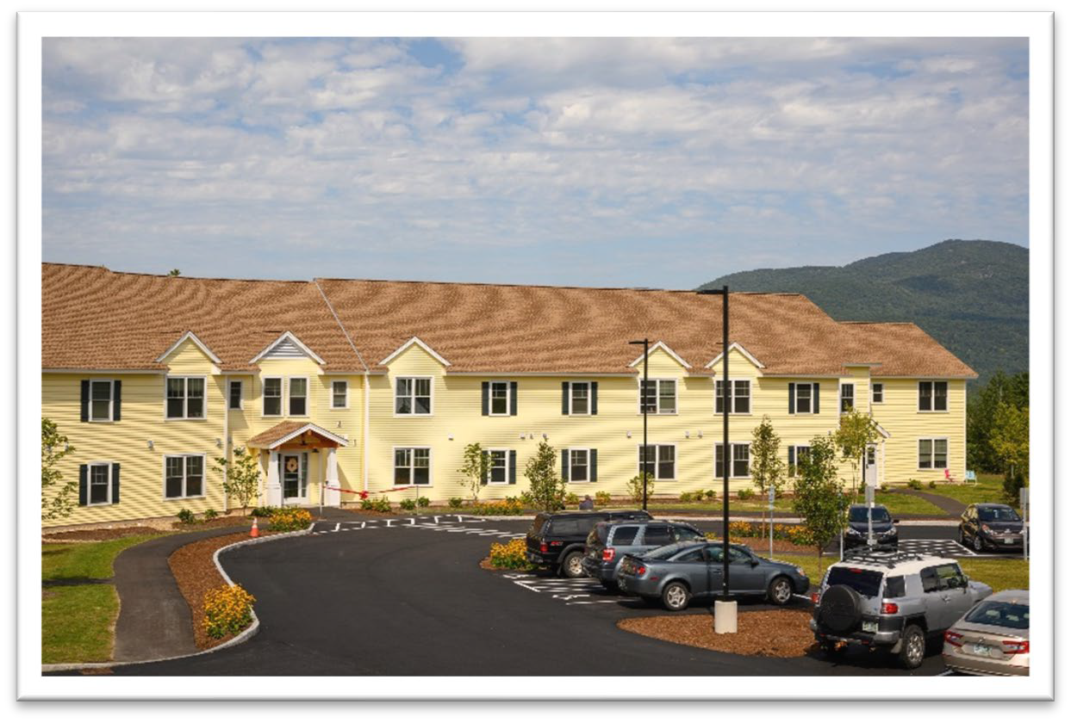
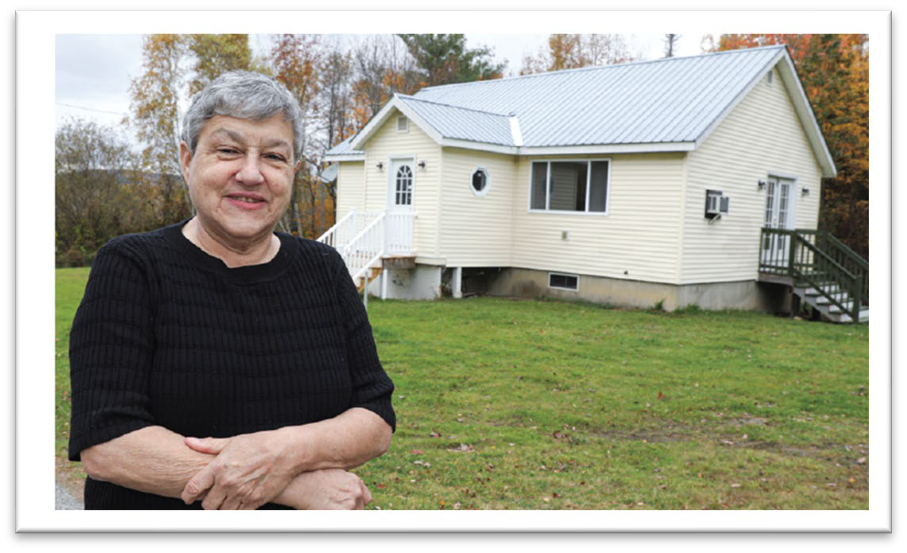
HOUSING & SERVICES TO SUPPORT VETERANS
Supportive Housing
Plymouth - Boulder Point
  25 one-bedroom apartments for veterans experiencing homelessness
Franklin - Military & Veterans Campus
  Housing & support for military
community members & families;
30 units of affordable rental housing
Nashua - Buckingham Veterans Transitional Housing (20 units)
Manchester Veterans Housing (26 units)
Nashua - Dalianis House (40 units)
FRANKLIN
Military and Veterans Campus (Easterseals)
Housing Choice Vouchers
Veterans Affairs Supportive Housing (VASH) Vouchers
|

Slide 9



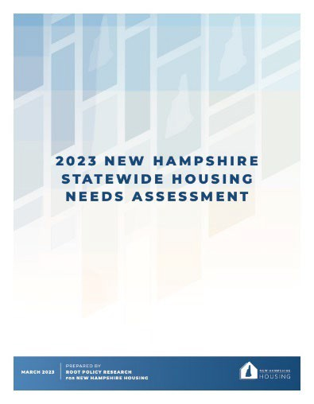



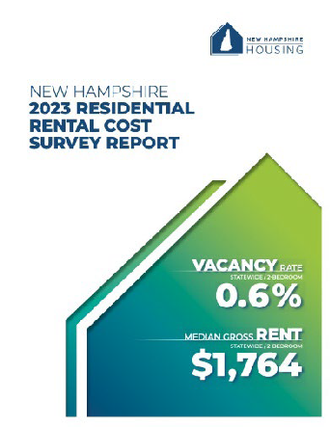


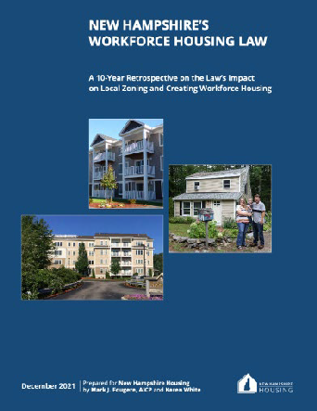
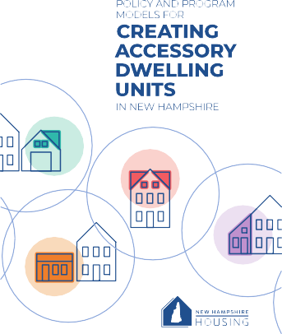

RESEARCH • ENGAGEMENT • POLICY
Housing Studies and Reports
Annual Residential Rental Cost Survey
Housing Planning Reports (state & federal)
Conferences focused on housing issues and policies
InvestNH Municipal Planning & Zoning Grants
|

Slide 10


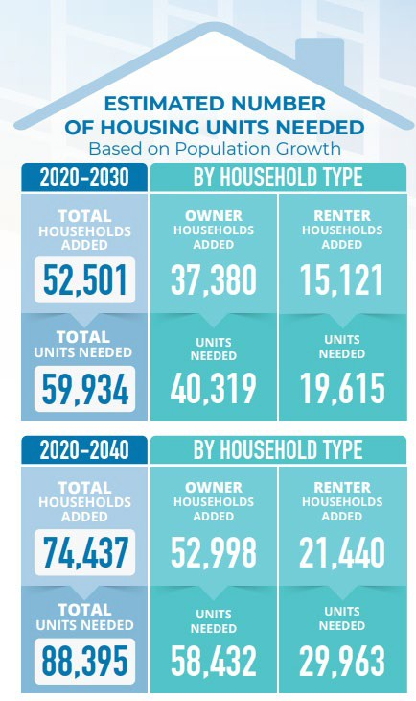
HOW MUCH HOUSING DOES NH NEED?
Based on estimated population growth:
Almost 60,000 units
between 2020 and 2030
Nearly 90,000 units
between 2020 and 2040
|

Slide 11
NH BUILDING PERMITS ISSUED 1980 - 2022
Single Family Units
Units in 2-unit Sturctures
Units in 3-and4-unit MF Structure
Units in 5+ Unit MF Structures
20000
18000
16000
14000
12000
10000
8000
6000
4000
2000
0
1980
1981
1982
1983
1984
1985
1986
1987
1988
1989
1990
1991
1992
1993
1994
1995
1996
1997
1998
1999
2000
2001
2002
2003
2004
2005
2006
2007
2008
2009
2010
2011
2012
2013
2014
2015
2016
2017
2018
2019
2020
2021
2022
Source: U.S. Dept. Of Commerce Construction Statistics Division
|

Slide 12
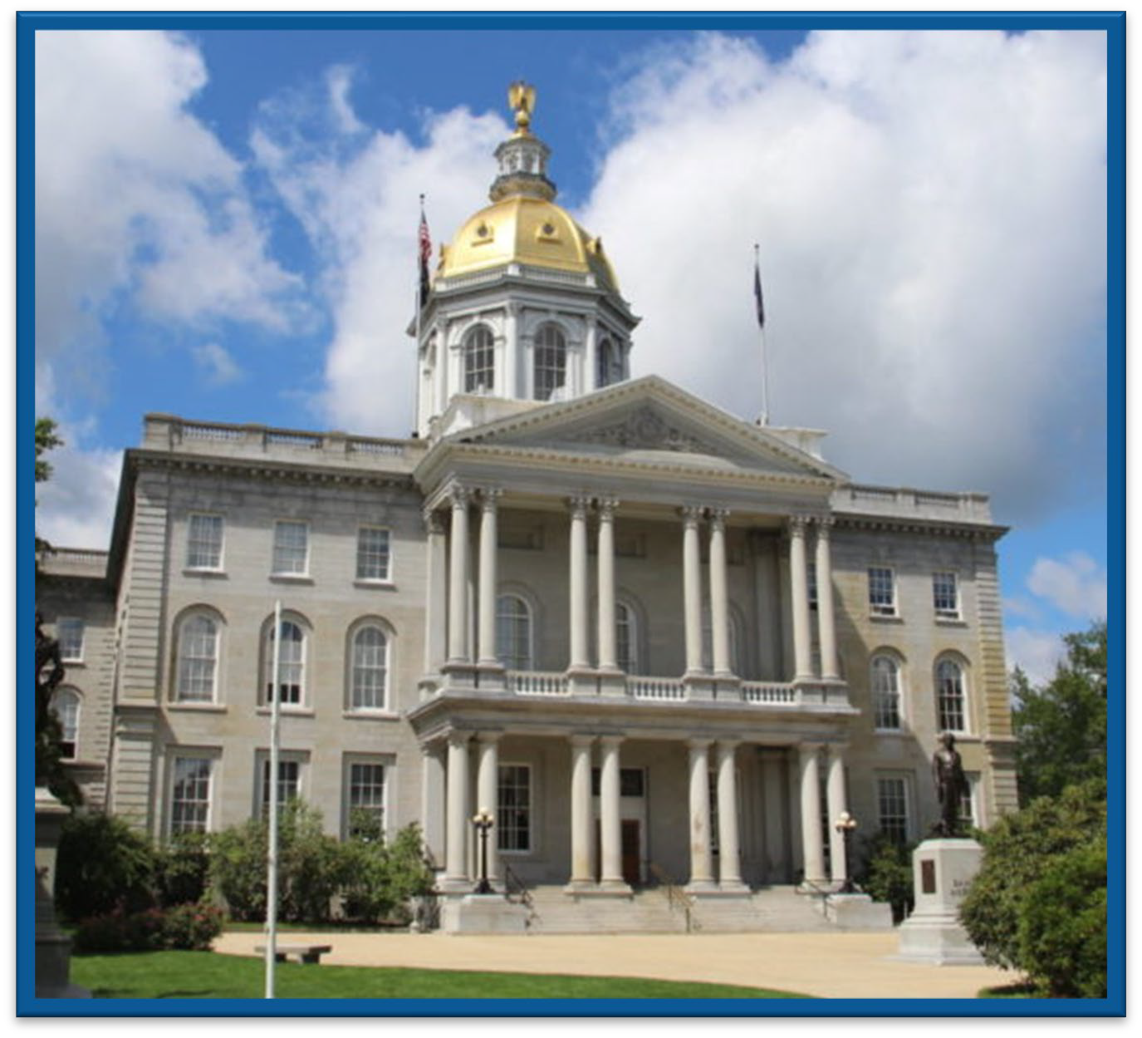
LEGISLATIVE ACTIVITY TO SUPPORT HOUSING SOLUTIONS
Progress in 2023
Affordable Housing Fund - $25 million one-time appropriation
InvestNH - $10 million
Housing Champions Designation for municipalities that adopt housing-friendly policies – eligibility for other funding
Coming up in 2024 Session
Special House Committee on Housing – bills on ADUs, permitting reform, septic systems, and others
Affordable Housing Fund – increase to the $5M annual appropriation
Historic Housing Preservation Tax Credit
No sprinklers for 3 & 4 unit conversions
Housing Appeals Board jurisdiction
|
12

