Slide 1
Introduction to
Veterans' Employment and Training Service
U.S. Department of Labor
Donna Nobrega, New Hampshire State Director

Slide 2

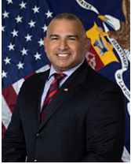
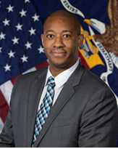

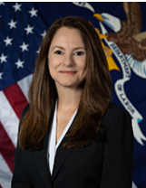
The Honorable James D. Rodriguez, MA
Assistant Secretary
Julian Purdy
Deputy Assistant Secretary for Policy
Margarita Devlin, MA, CRC
Deputy Assistant Secretary for Operations and Management
Veterans’ Employment and Training Service

Slide 3
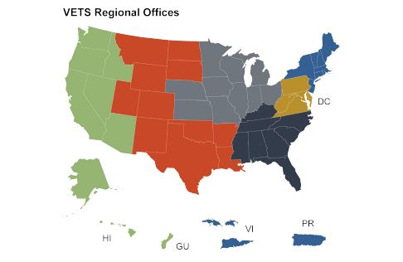
VETS National Presence
Headquarters in D.C.
Click Here for National Office Staff
Six Regional Offices
Click Here For Regional Office Staff
Click Here to contact the RVEC near you
VETS staff in all 50 states and territories
Regional Veteran Employment Coordinator (RVECs)
Boston
San Francisco
Chicago
Philadelphia
Dallas
Atlanta

Slide 4
VETS: Who We Are
DOL VETS is the lead Federal Agency in Veteran Employment
FY2022: 2,800+ DOL VETS staff, contractors, and grantees served 440,000+ veterans and military spouses across all Agency programs
VETS leverages all DOL agencies/resources on behalf of veteran employment, transitioning service members and military spouses
VETS is the voice of DOL in the veteran employment space and the voice for veterans within DOL

Slide 5

DOL Agencies Serving Veterans and Military Spouses
Veterans’ Employment and Training Service (VETS)
  Coordinates Agency efforts
Employment & Training Administration (ETA)
  National Workforce System -American Job Centers (AJCs)
  Unemployment Compensation (UCX), Office of Apprenticeship, Workforce Innovation and Opportunity Act (WIOA), Grants
Office of the Solicitor (SOL)
  Employment law expertise; subpoena and referral assistance in Uniformed Services Employment and Reemployment Rights Act (USERRA) cases.
Bureau of Labor Statistics (BLS)
  Continuously monitors and analyzes U.S. Veteran employment statistics
Chief Evaluation Officer (CEO)
  Evaluates effectiveness /efficiency of Veteran employment programs
Office of Disability Employment Policy (ODEP)
  Focuses on disability-related policies that benefit Veterans
Office of Federal Contract Compliance Programs (OFCCP)
  Affirmative action provisions of Vietnam Era Veterans Readjustment Assistance Act (VEVRAA)
Women’s Bureau (WB)
  Develops policies, advocates for equality and economic security and promotes
  quality work environments for working women
Wage and Hour Division (WHD)
  Military Family Leave Act (FMLA)
Employee Benefits Security Administration (EBSA)
  Financial literacy/military retirement structure

Slide 6

We prepare America’s veterans, transitioning service members, and their spouses for meaningful careers
We provide them with employment resources and expertise
We protect their employment rights
We promote their employment opportunities
VETS Mission

Slide 7
VETS Vision and Priorities
Leveraging partnerships to maximize employment outcomes
Promote and advance equity, inclusion, and accessibility in our underserved veteran communities
Enabling all veterans, transitioning service members, and military spouses to reach their full potential in the workplace
Getting the military to civilian employment transition right
VETS Priorities
VETS Vision

Slide 8





































Leveraging Partnerships

Slide 9
The Big Picture
Federal Administration (FA)
Transition Assistance Program (TAP)
Homeless Veteran Re-integration Program (HVRP)
National Veterans Training Institute (NVTI)
Uniformed Services Employment and Reemployment Rights Act/Veterans Preference (USERRA & VP)
Budget Activities & Programs
Jobs for Veterans State Grants (JVSG)
Hire Vets Medallion Program (HVMP)
Understanding VETS Appropriations
  5 Budget activities: FA, JVSG, TAP, HVRP, & NVTI
  1 Fee-based program: HVMP
  2 Grants programs: JVSG & HVRP
  2 Contract-driven programs: TAP & NVTI
  1 Program funds all FTEs to oversee agency activities and
  WCF: FA

Slide 10
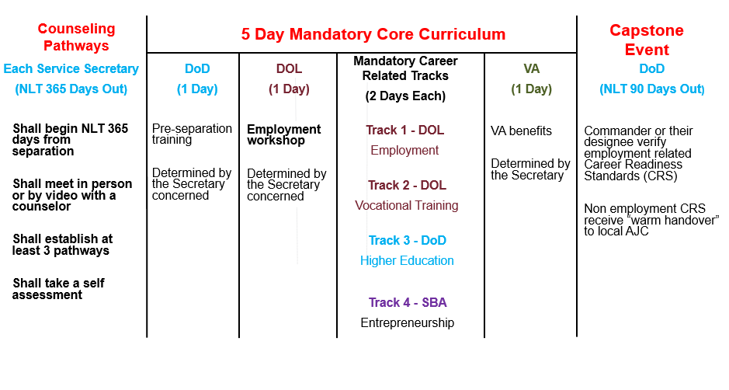
Prepare: Transition Assistance Program (TAP)
FY22 TAP Delivery
11,753 DOL (1&2-day) Employment Workshops
To over 246,000 TSMs
>200 locations worldwide
1,115 Vocational Training / "Career and Credential Exploration" Workshops
Begin NLT 365 days from separation
Meet in person by video or with a counselor
Establish at least 3 pathways
Take a self assessment

Slide 11

TAP: Supplemental Programs
Employment Navigator Partnership Pilot (ENPP)
First time in program history in-person employment assistance outside the classroom
7,683 transitioning service members
531 Military Spouses
Transition Employment Assistance for Military Spouses (TEAMS)
1st four workshops delivered virtually Sep 2020 - every month (Your Next Move, Career Credentials, Mastering Resume Essentials, Marketing Me)
Five additional workshops added Sep 2021 (Federal Hiring, Interview Skills, Salary Negotiation, LinkedIn Profiles, LinkedIn Job Search)
Served through December 31, 2022:
In FY 2022, 1,203 military spouses attended 270 separate modules of TEAMS curriculum
New workshop added Oct 2022 (Flexible Job Options)
In Oct 2022, TEAMS workshops are available by request in classrooms on installations.
ENPP Locations
Service | Pilot Location
Army | Fort Benning, GA
Army | Fort Drum, NY
Army | Fort Shafter, HI
Army | Fort Sill, OK
Army | Schofield Barracks, HI
Army | USAG Bavaria, Germany
Marine Corps | Camp Pendleton, CA
Marine Corps | MCAS Miramar, CA
Marine Corps | MCAS Cherry Point, NC
Marine Corps | Multiple TAP sites in Okinawa
Marine Corps | Wounded Warrior Bn, Camp LeJeune, NC
Navy | Naval Station Norfolk, VA
Navy | CFA Yokosuka, Japan
Air Force | Travis Air Base, CA
Air Force | Kadena Air Base, Okinawa
Joint Base | Charleston, SC
Joint Base | Pearl Harbor-Hickam, HI
Joint Base | Little Creek, VA
Joint Base | Langley-Eustis, VA

Slide 12
Transition Assistance Program Initiatives
Wounded Warrior & Caregiver Employment Workshop
17K participation through Sept 2022
Off Base Transition Training (OBTT) Pilot
Pilot states (CA, MA, NC, PA, TX). Plans to expand to 20+
Conduct brick & mortar workshops started January 2022
Virtual instructor led workshops started January 2022
Contracted staff to coordinate/promote connection between Reserve Component members and American Job Centers
Developed in coordination with Service’s Warrior Transition Programs
FY 2022 Workshop attendance (January – September)
1,097 participants attended a total of 1,239 separate in-person workshop modules
486 participants attended a total of 172 separate virtual workshop modules

Slide 13
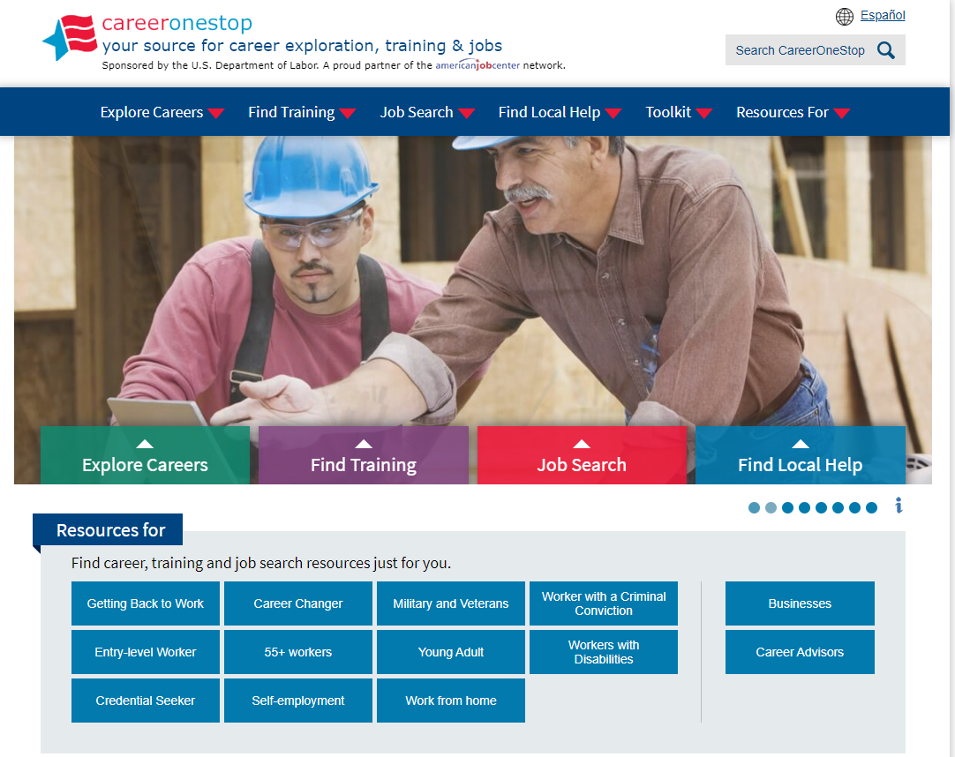
Provide: American Job Centers Serve All Veterans
Jobs for Veterans State Grants (JVSG)
The Department of Labor has 2,335 American Job Centers (AJCs) across the country
Jobs for Veterans State Grants (JVSG) serve veterans with significant barriers to employment.
VETS Funds 1,700+ JVSG staff in the AJCs across the country.

Slide 14
New Hampshire Employment Security (NHES) JVSG Program
The U.S Department of Labor provides the State of New Hampshire with federal funding for The Jobs for Veterans State Grant (JVSG).
This grant is administered by New Hampshire Employment Security (NHES) also know as NH Works.
The JVSG program authorizes funds to each state to staff and support Disabled Veterans’ Outreach Program (DVOP) specialists and Local Veterans’ Employment Representative (LVER) staff.
In the current year, the state of New Hampshire was awarded $760,831 in JVSG funds which employ six DVOP and one LVER position located in career centers/NH Works offices.

Slide 15

AJC Services for Employers
Locate the closest AJC to your facility
www.careeronestop.org
Contact a Local Veterans’ Employment Representative (LVER) or Business Services staff
Business Services: Works with employer to enter open positions into the state workforce system
LVER: Works with the employers assists with sourcing viable Veteran candidates
Let them know you want to hire Veterans
No Cost Employer Services
Job description writing
Posting job openings
Reviewing applicants’ resumes
Pre-screening of job applicants
Assessment of applicants’ skills
Referral of job-ready candidates
Workforce information
Skill upgrading and career ladders
OJT, Internships, Apprenticeships
Places to conduct interviews
Organizing job fairs

Slide 16
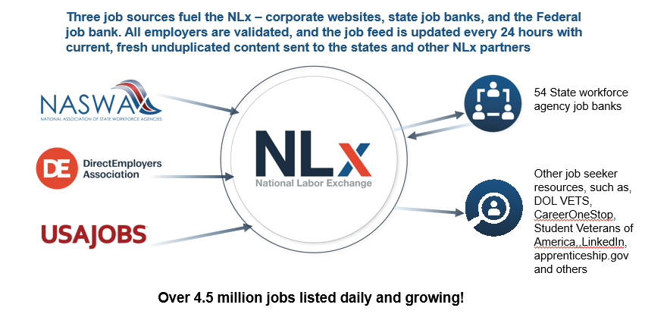
National Labor Exchange (NLx)

Slide 17
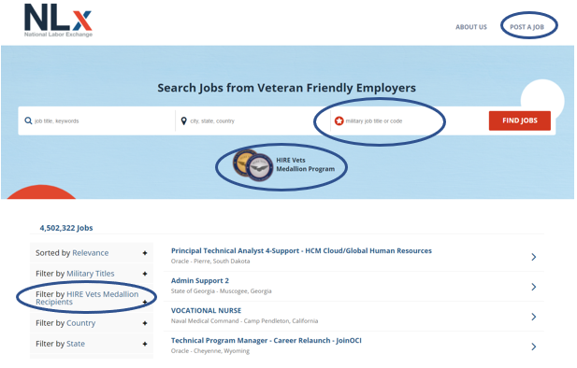
National Labor Exchange (NLx)
www.veterans.usnlx.com

Slide 18
Additional Resources
Work Opportunity Tax Credit for employers
Federal Bonding Program for job-seekers
Veteran Treatment Courts for justice involved veterans
Notes:
We all know the benefits of hiring a veteran, the first two resources provide additional benefits to employers. For your information and to share with your employer partners.
First is a tax credit and the second bullet is a bonding program for employers who are hiring our veterans who may have been involved with the justice system.
Speaking of the justice system, we are creating a strong partnership with the veteran treatment courts across the country. We can work with you at the state level to ensure your veterans in these situations can get the support and resources they need.

Slide 19
Employment Services for Homeless Veterans
Homeless Veterans’ Reintegration Program (HVRP)
VETS provided annual funding to approximately 166 grantees in FY 2022
Grantees served over 17,000 homeless veterans in FY 2020
Homeless Women Veterans and Homeless Veterans with Children (HWVHVWC)
Grantees provide services to eligible homeless female veterans and homeless veterans with families
Incarcerated Veterans’ Reintegration Program (IVTP)
Grantees provide services to eligible formally incarcerated and those transitioning from incarceration
Stand-Down Grants
Stand Down events serve as gateways into structured housing and reintegration programs
Stand Down organizers partner with VA and social service providers to offer critical services

Slide 20
New Hampshire HVRP Profile
HVRP is a competitive grant program which focuses on employment and re-training for homeless veterans.
In the current year, Harbor Homes aka Harbor Care, Veterans Inc., Clear Path for Veterans New England, and the Bridge Club of Greater Lowell received these grants which serves veterans who are at risk of becoming homeless or experiencing homelessness.
While Veterans Inc., Clear Path, and Bridges of Greater Lowell headquarters are located in Vermont and Massachusetts their service areas overlap into New Hampshire. Together, these four grantees receive over $1.5 million dollars from our agency, to assist veterans who are at risk or experiencing homelessness.

Slide 21
New Hampshire HVRP Grantees
Harbor Care aka Harbor Homes
(Located in Nashua, and Plymouth, NH)
Veterans Inc.
(Located in Bradford, VT)
Clear Path for Veterans New England
(Located in Devens, MA)
The Bridge Club of Greater Lowell
Service areas include Coos, Grafton, Carroll, Belknap, Sullivan, Merrimack, Hillsborough, Rockingham, Strafford, and Cheshire counties.
New Hampshire: Merrimack, Sullivan, Strafford, Grafton Counties, and city of Manchester.
Vermont: Windsor, Washington, Orleans, Caledonia, and Orange Counties, as well as the communities of Killington, Chittenden, and Pittsfield (located in Rutland County).
New Hampshire: Cheshire, Hillsborough, and Rockingham Counties
Massachusetts: Essex, Franklin, Hampden, Middlesex, and Worcester Counties
(Located in Lowell, MA)
IVTP – Focus on incarcerated veterans.
Service areas include Essex and Middlesex, MA. Hillsborough and Rockingham counties in NH.
Goal to serve 90 participants yearly.
Goal to serve 106 participants yearly.
Goal to serve 124 participants yearly.
Goal to serve 70 participants yearly.

Slide 22

National Veteran’s Training Institute
Established to further develop and enhance professional skills of Department of Labor (DOL), grant-funded veterans’ employment and training service providers.
Our Course Catalogue includes 28 courses with multiple delivery methods.
Online cohort – instructed led
Self-paced
In-person classroom
Microlearning: 7 - 12 minutes, single topic learning
Podcasts
Virtual classroom
All courses are available for DOL grant-funded staff and are currently virtual, our schedule is found at www.NVTI.org
Return to in-person courses began January 2023 (some still virtual)

Slide 23

Protecting Employment Rights
Uniformed Services Employment and Reemployment Rights Act (USERRA); 38 U.S.C. 4301-4335
VETS administers USERRA with the support of ESGR, DOJ, and OSC
Protects employment rights for veterans, active duty, and members of the reserve components
Most cases are resolved without the need for enforcement…
Claimants can refer cases to DOJ or OSC
DOJ and OSC satisfactorily resolve most referred cases with merit
Veterans’ Preference in Federal Hiring; 5 U.S.C. 3330a
VETS investigates complaints veterans’ preference rights in Federal hiring were violated

Slide 24
Promote: Employer Outreach Program
Connect Employers with Federal, State and Local Resources
Leverage Resources to Reduce Employer Costs
Assist Employers Needs, Address Skill Gaps and Attract veteran Talent
Coordinate Across Local and Strategic Partnerships
Make it easier for employers to find and hire veterans

Slide 25

Veteran Demographics
180K-200K Transition Annually
45% of the Veteran workforce are GWII Veterans
18M Veterans
48% (8.6M) in Workforce
5.5% of US Workforce
63% are 45 yrs. or Older
18-24 Yr. Group = 2.3% Workforce
Women: 51
Men: 65
Median Age: 64
57% of unemployed Veterans are 45 years or older​

Slide 26
Veterans’ Attributes in the Workplace
Lead / Follow
Mission Oriented
Versatile
Work Ethic
Loyalty
Technical Skills
Diverse Backgrounds

Slide 27
Good Business Decision to Hire Veterans
Some of Our Nation’s Best and Brightest Choose to Serve
Veterans and their families have a higher standard of living than non-veterans over the past 40 years - 17% in 2019. (*Pew Research Center)
Additional Research: Syracuse University’s Institute for Veterans and Military Families (IVMF) The Business Case for Hiring A Veteran: Beyond the Clichés
Veterans are more productive and have higher retention rates
Veterans have lower unemployment rates and higher labor participation rates than their non-veteran peers (*BLS)
Only 23% of 17–24 year-olds Qualify for Military Service (*DoD)
Studies show:

Slide 28
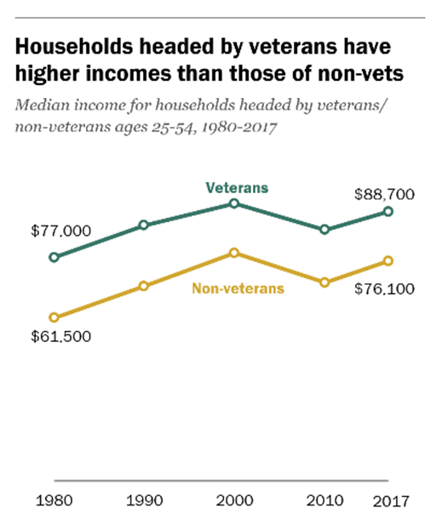


Veterans Outperform Their Non-Veteran Peers
“Veterans are 39% more likely to be promoted earlier than non-veterans.”
“Post 9/11 veterans earn more than those who never served in the Armed Forces”
Nov 2020
Pew Research Center, Dec 2019

Slide 29
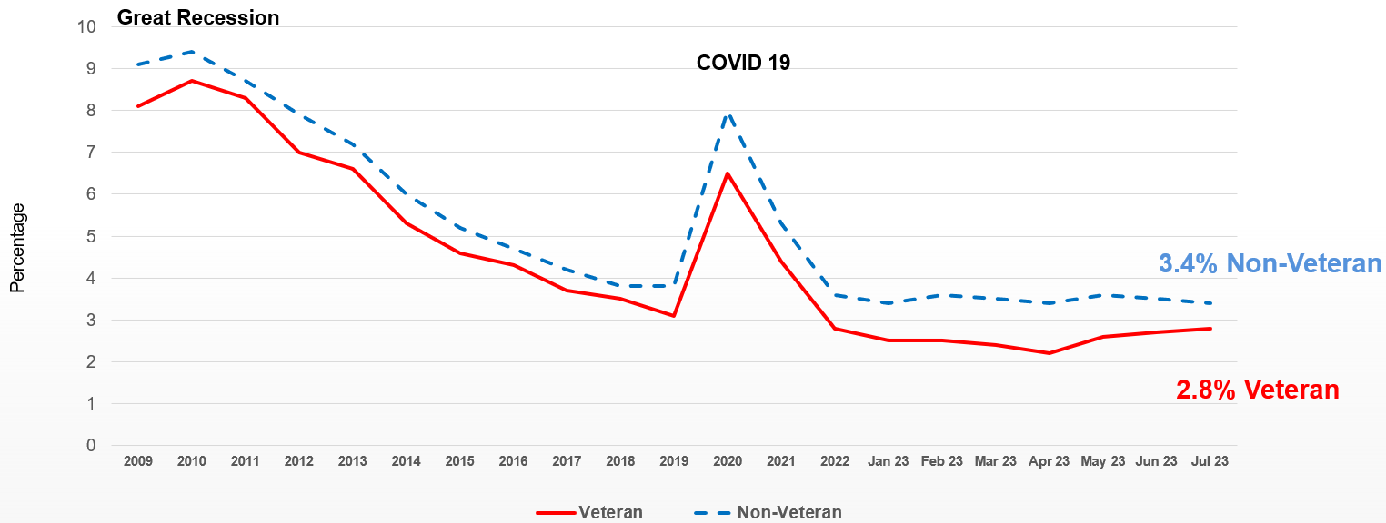
Unemployment Rate Veterans / Non-Veterans

Slide 30

Finding and Hiring Veterans
The key to success is building and leveraging a network of no-cost resources:
State Workforce Agencies
American Job Centers / CareerOneStops
State Job Banks / National Labor Exchange
Federal Resources
Marine For Life, Soldier For Life, SkillBridge, National Guard Bureau
Veteran Service Organizations
US Chamber of Commerce Hiring Our Heroes Events
Review our Employer Guide
https://www.dol.gov/sites/dolgov/files/VETS/files/Employer-Guide-to-Hiring-Veterans.pdf
HIRE Vets Medallion Program (HVMP)
Employer
Guide to
Hiring
Veterans
Employer
Guide to
Hiring Veterans
VETERANS’ EMPLOYMENT AND TRAINING SERVICE
UNITED STATES DEPARTMENT OF LABOR

Slide 31
HIRE Vets Medallion Program
The only Federal Award that Recognizes Employers Who: Hire, Retain and Support Veterans
835 employers earned the 2022 HIRE Vets Medallion Award
See them on the map at HIREVets.gov/Awardees
2023 Application period: January 31 – April 30, 2023
HIREVets.gov

Slide 32
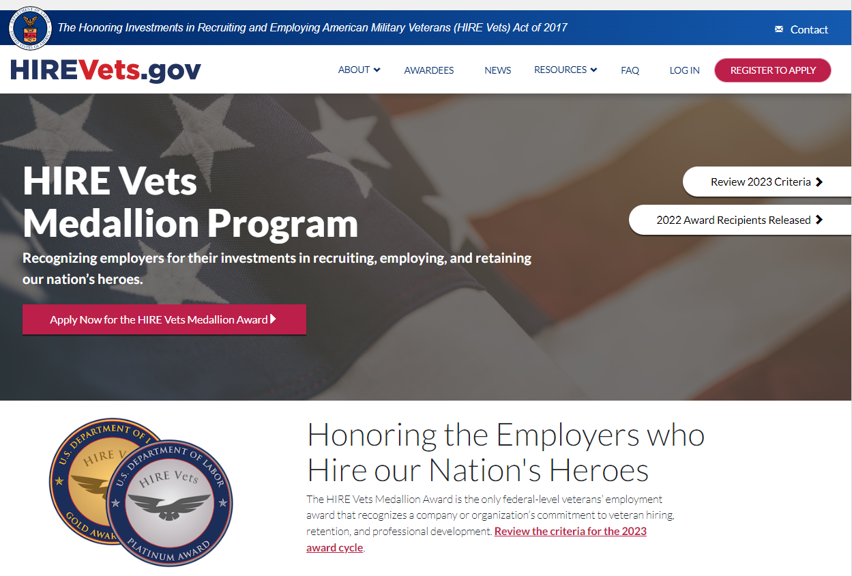
HIRE Vets Medallion Program
Notes:
VETS serves unemployed and homeless Veterans most in need, many of whom have significant barriers to employment that can be addressed through VETS’ grant programs.
VETS increased the maximum funding in FY 2017 for a Homeless Veterans’ Reintegration Program (HVRP) grant from $300,000 to $500,000 – the first increase since the grant program’s inception.
Homeless Veterans served by an HVRP grant are also enrolled at their local American Job Center to ensure they can access and participate in the training provided through th

Slide 33
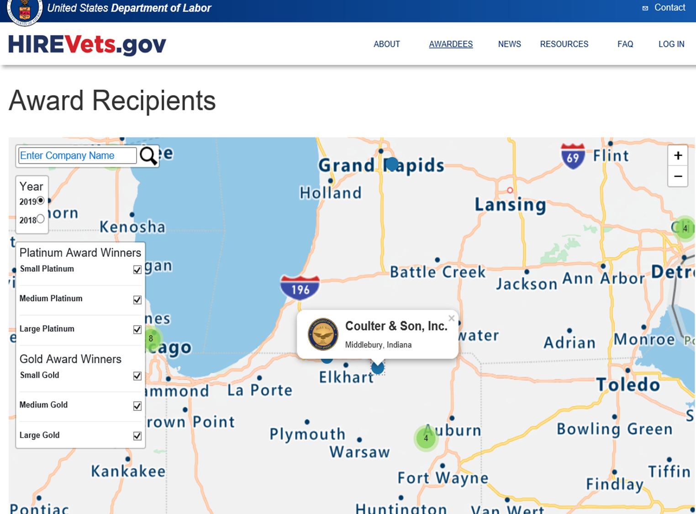
HVMP Value Proposition
Employers | Veterans
Only Veteran hiring award at the Federal level | Globally Identifies a proven “Veteran ready” employers
Assists in recruitment and advertising effort Published list of award recipients | Assists in recruitment and job search effort Published list of award recipients
Certificate/Award from the Secretary of Labor | Transition Service Members Are Taught Where and how to look for a HVMP Recipient
Rights to a “Digital” Medallion with year of award to use | Veterans are will be looking for the Medallion
Could mean differentiation over competitors | Veterans have options when looking for employment….
HIREVets.gov/Awardees
Slide option

Slide 34
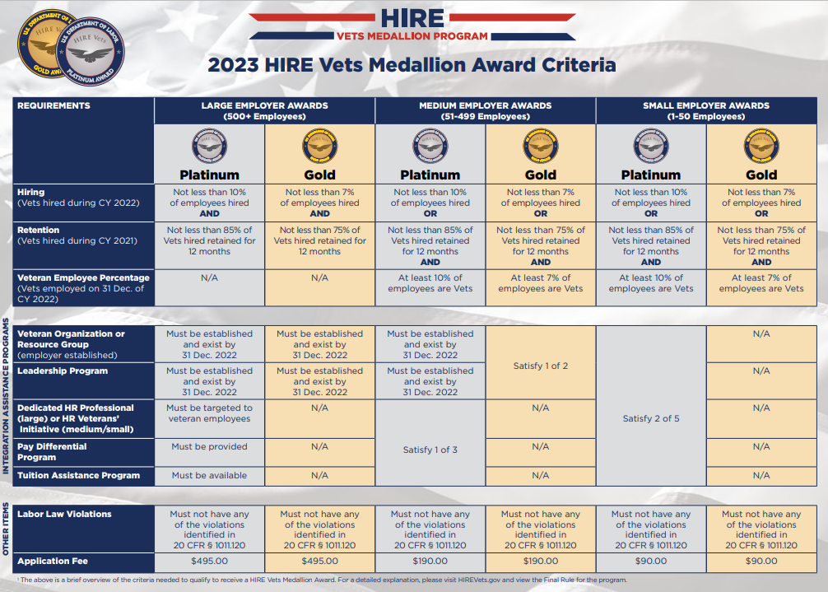
HIREVets.gov

Slide 35
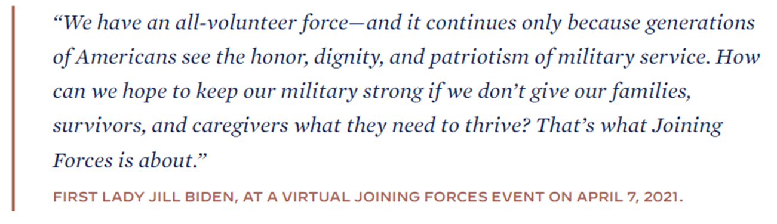


White House Joining Forces: Military Spouses

Slide 36
THE MILITARY SPOUSE
“The Force Behind the Force”
Military Spouses move 10X more frequently
88% of Military Spouses have some post high school education; 34% have college degrees; 15% have a graduate degree
~16% Military Spouse unemployment rate
~35-40% Military Spouse underemployment
38% earn less than their civilian counterpart
Licensure transferability issues -- 35% work in field requiring a license
Enabling all veterans, transitioning service members and military spouses to reach their full potential in the workplace

Slide 37

For Military Spouses & Survivors
Eligible spouses may also qualify for our Dislocated Worker Program, Displaced Homemaker, and other services at their local American Job Center
Eligible family members under the Family and Military Family Leave (FMLA) Act may take up to 26 work weeks of military caregiver leave to care for a service member with a serious injury or illness incurred or aggravated in the line of duty
www.dol.gov/agencies/vets/veterans/military-spouses

Slide 38
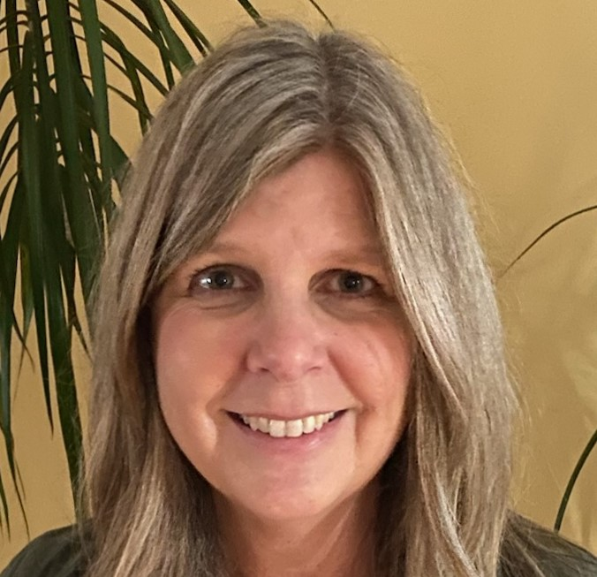
Local Contact Information
Donna Nobrega
    DOL-VETS, New Hampshire, State Director
      nobrega.donna.m@dol.gov
        (202) 527-3129 or (603) 225-1424

Slide 39
