Slide 1
Recovery Friendly Workplace Overview
11/7/23
Presented by: Kristie Curtis, Recovery Friendly Workplace Advisor

Slide 2
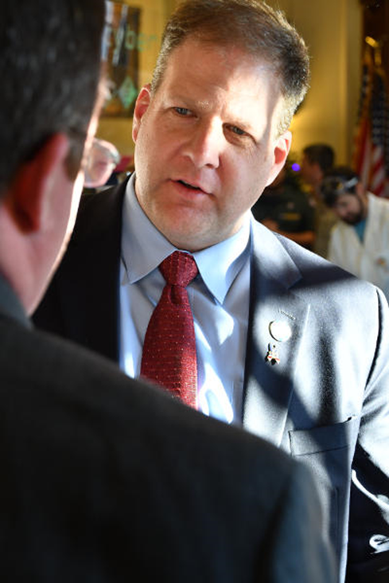
Led by Governor Chris Sununu
Launched in March of 2018
Promotes health, safety, and wellness for NH workplaces and employees
Empowers workplaces to provide support for employees in recovery and those impacted by substance use disorders
Challenges stigma
Encourages employee retention and productivity
Recovery Friendly Workplace

Slide 3
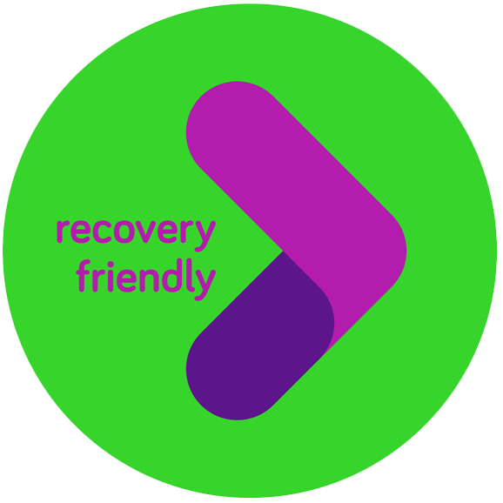
Why Should Employers Get Involved?
Workplaces are already employing those with SUDs
~135,000+ in recovery in NH
Over 20 million, ~10% (SAMHSA, 2018)
~9.1% resolved SUD in 2017 (Kelly et al., 2017)
Nearly 1 in 2 indirectly impacted (PEW Research Center, 2017)
Work is where we reach people
Attract/retain talent
Additional benefits of addressing SUDs:
- Productivity
- Employee health
- Morale
- Communication
- Employee satisfaction
- Community connection
- Customer loyalty
- Absenteeism
- Turnover
- Impact on families
Notes:
Likely employing those with SUDs
66% of adults who misuse opioids are employed
~7.2 million U.S. adult workers reported misusing an opioid at some point in 2016. This can affect any employees regardless of their industry or occupation.
Alcohol misuse
Alcohol abuse resulted in an estimated 9,315 fewer male workers and 2,877 fewer female workers in New Hampshire’s labor force in 2014, an overall reduction in the state’s labor force of 1.65 percent
Per Dean’s Trainer Manual: “All in all, over 20 million people – or about 10% of the U.S. population at any given time– meets criteria for a substance use disorder. And while not everyone needs formal treatment, less than 15% of those with a SUD receive any kind of treatment. Many studies have proven that the biggest factor for untreated substance use disorders is the stigma attached to illicit drug use and disordered substance use.”
Benefits
· Higher Productivity
· Healthier Employees
· Less Absenteeism
· Decreased Turnover
· Increased Morale
· Improved Communication
· Greater Employee Satisfaction
· More Community Connection
· Increased Customer Loyalty

Slide 4
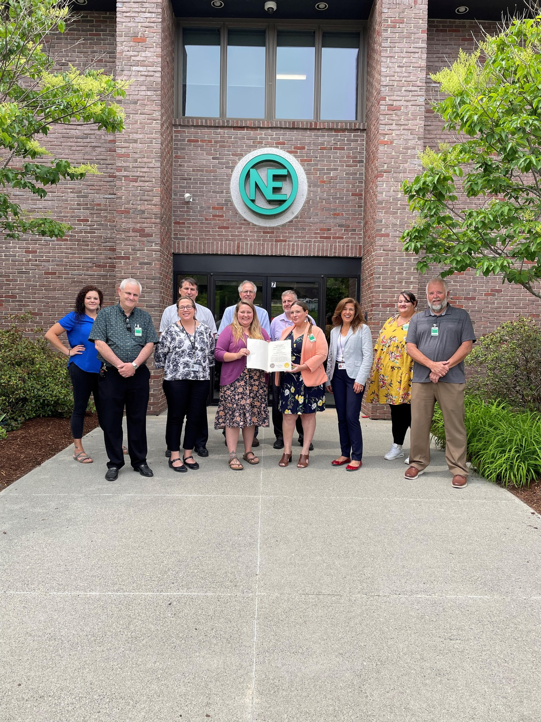
Cultural Goals
Moving workplace along continuum of culture change (especially as relates to reducing stigma and increasing psychological safety)
Understanding of SUD as complex health condition deserving of parity
Leadership/management equipped with knowledge, tools, and resources needed to support employees
Employees
Feel safe coming forward
Experience a supportive approach even if conversation is not employee-initiated
Know rights/policies/processes
Know variety of resources/pathways
Openness to hiring whoever is best for the job
Recognition of recovery as a strength
Image: New England Wire in Littleton, NH, shows their RFW Designation, with RFW & Public Health Network partners from NCHC.

Slide 5
RFW Trainings
“In Person”¹
“In Person”¹ or Online (Self-Paced)
New Content – Online Only Currently
Why the Workforce Needs People in Recovery
Understanding SUD, Bias, Stigma, & Discrimination
Accessing Resources in NH: 211 & The Doorway
Signs & Symptoms, Reasonable Suspicion, Legal Considerations, & How To Have a Supportive Conversation With Employees
Training for Management: How To Navigate SUD Concerns/Support Employees’ Recovery
Overcoming the Impact of Substance Use Disorders through Recovery: A Panel Discussion
RFW Panel: Journeys, Processes, Policies & Practices, and Outcomes
How To Save a Life With Narcan
Diversity, Equity, & Inclusion for NH Workplaces
Family Supports: How to Support a Loved One With SUD (and Keep Taking Care of Yourself in the Process)
Self-Care During Times of Isolation
About Recovery & Workplace Wellness
RFW Overview &
Growing Your Recovery Friendly Workplace
Employer & Employee Vignettes
Addressing Compassion Fatigue & Burnout
¹ “In person” refers to a training that is conducted live-time, either via Zoom or in person when conditions permit.

Slide 6
Education & Resources: Some Examples

Slide 7
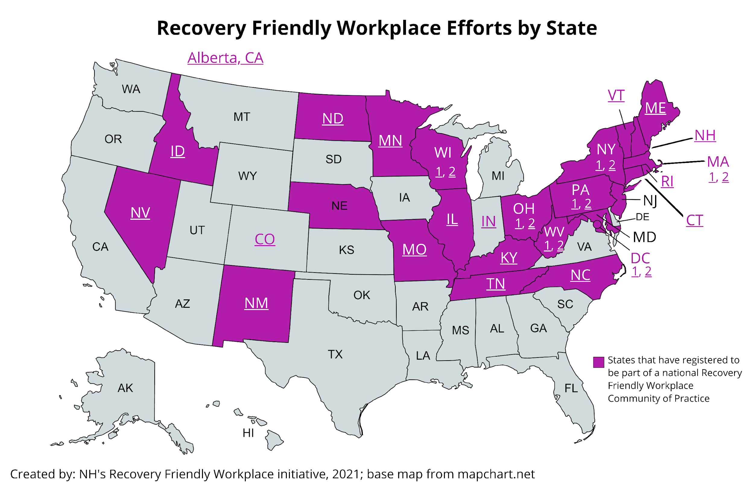
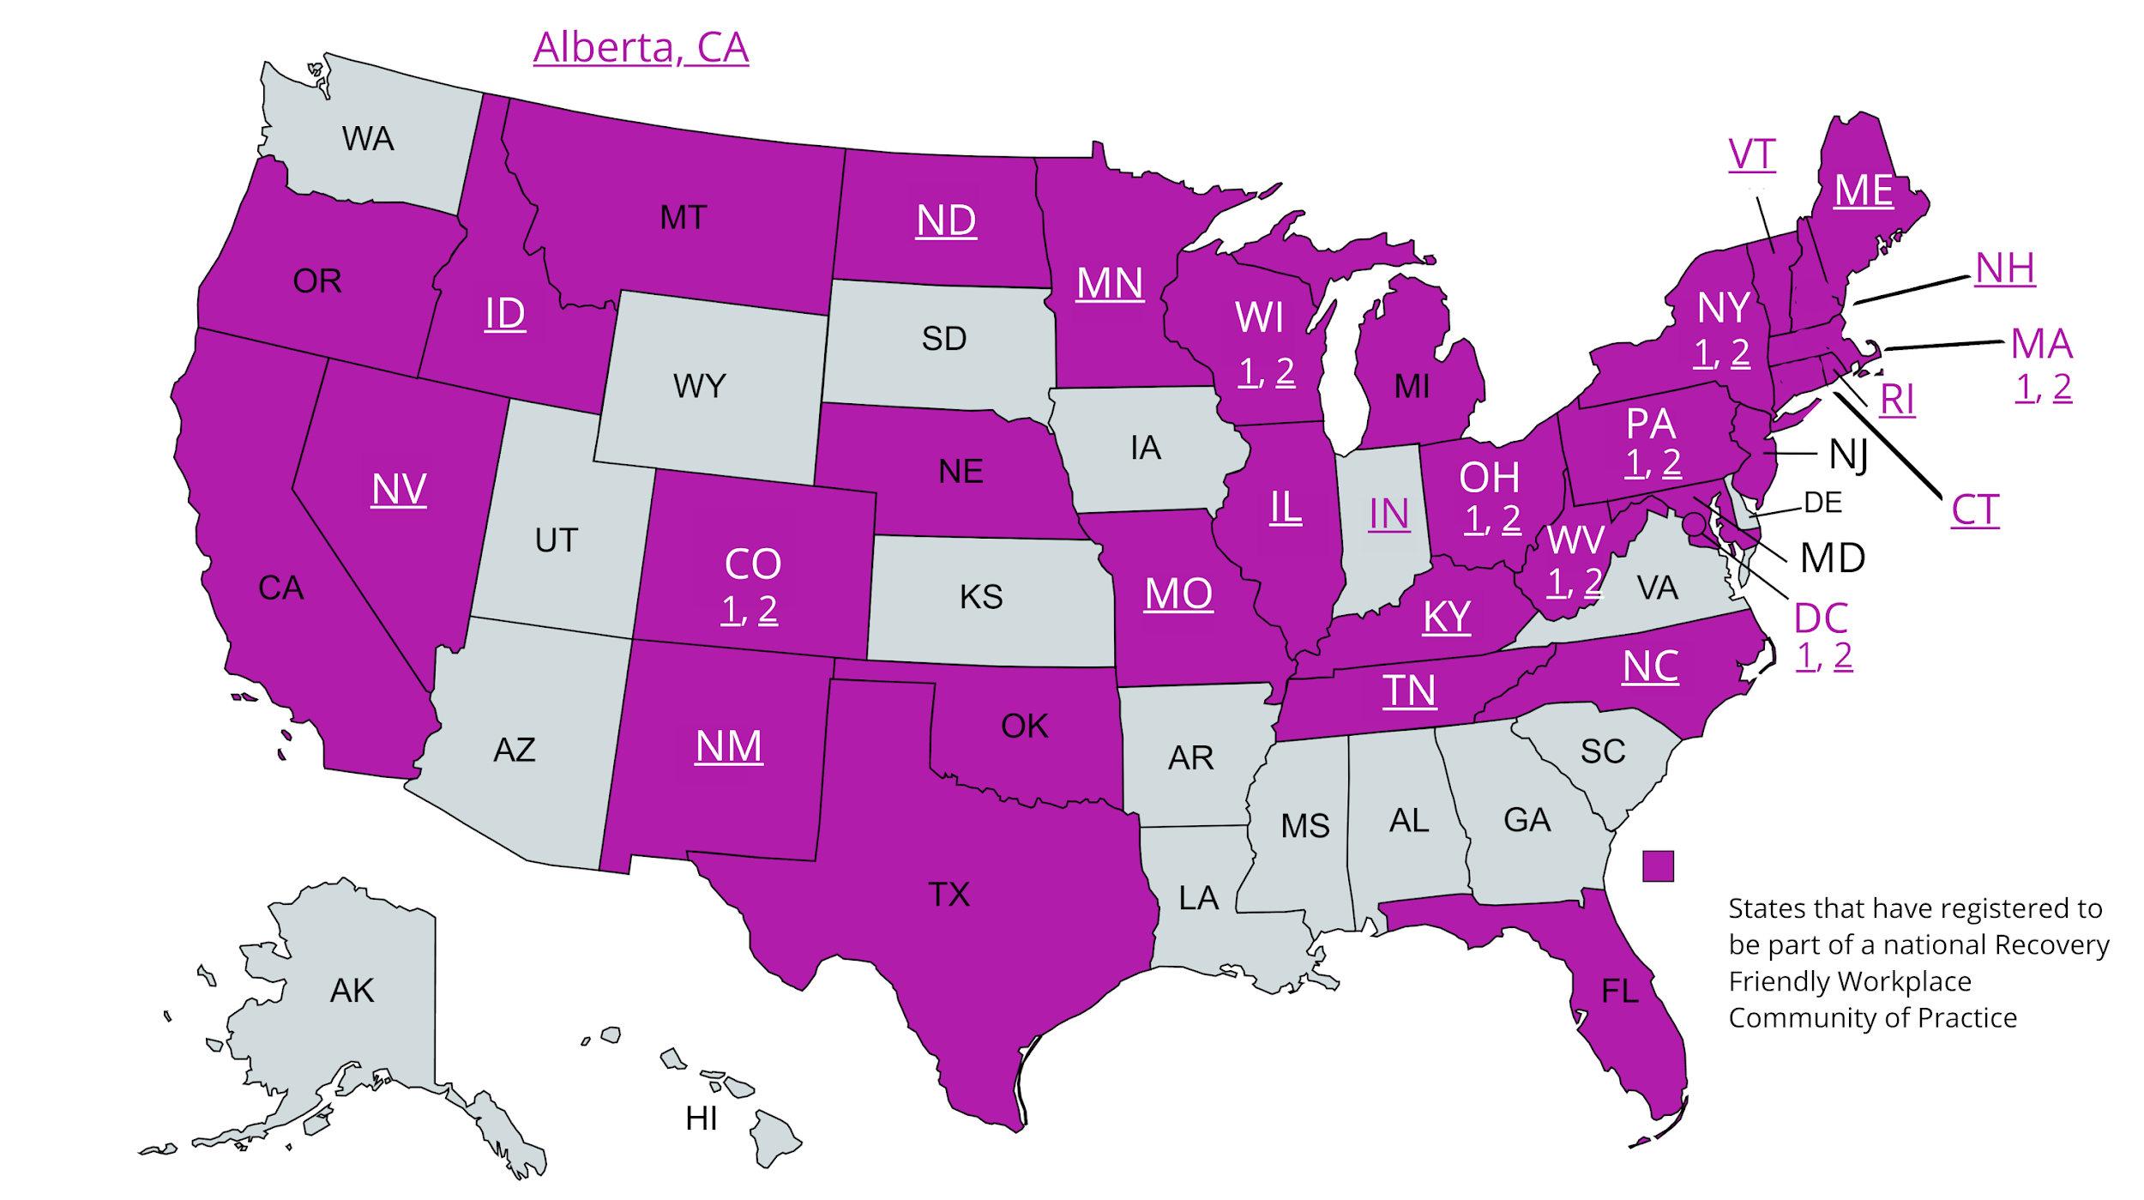
November 2021
March 2023
Growth of National Efforts
Engagement With RFW Multi-State Community of Practice
Engagement With RFW Multi-State Community of Practice
Created by: NH’s Recovery Friendly Workplace initiative, 2021; base map from mapchart.net
Created by: NH’s Recovery Friendly Workplace initiative, 2022; base map from mapchart.net

Slide 8
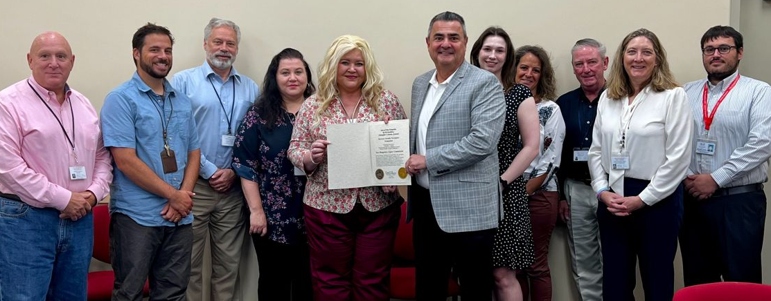
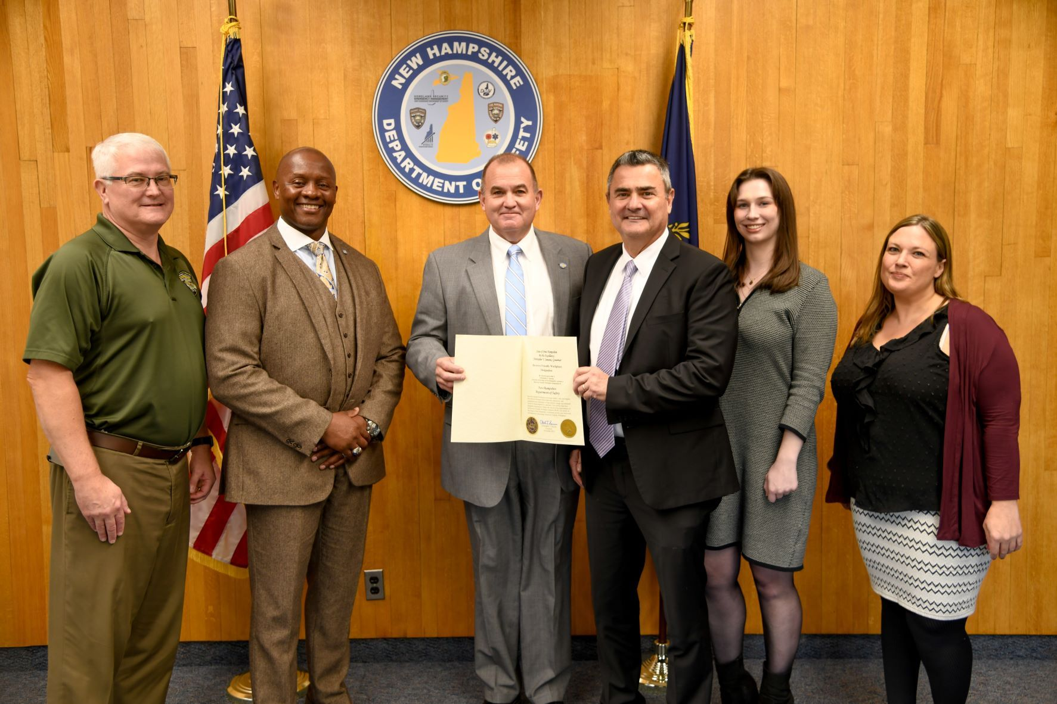
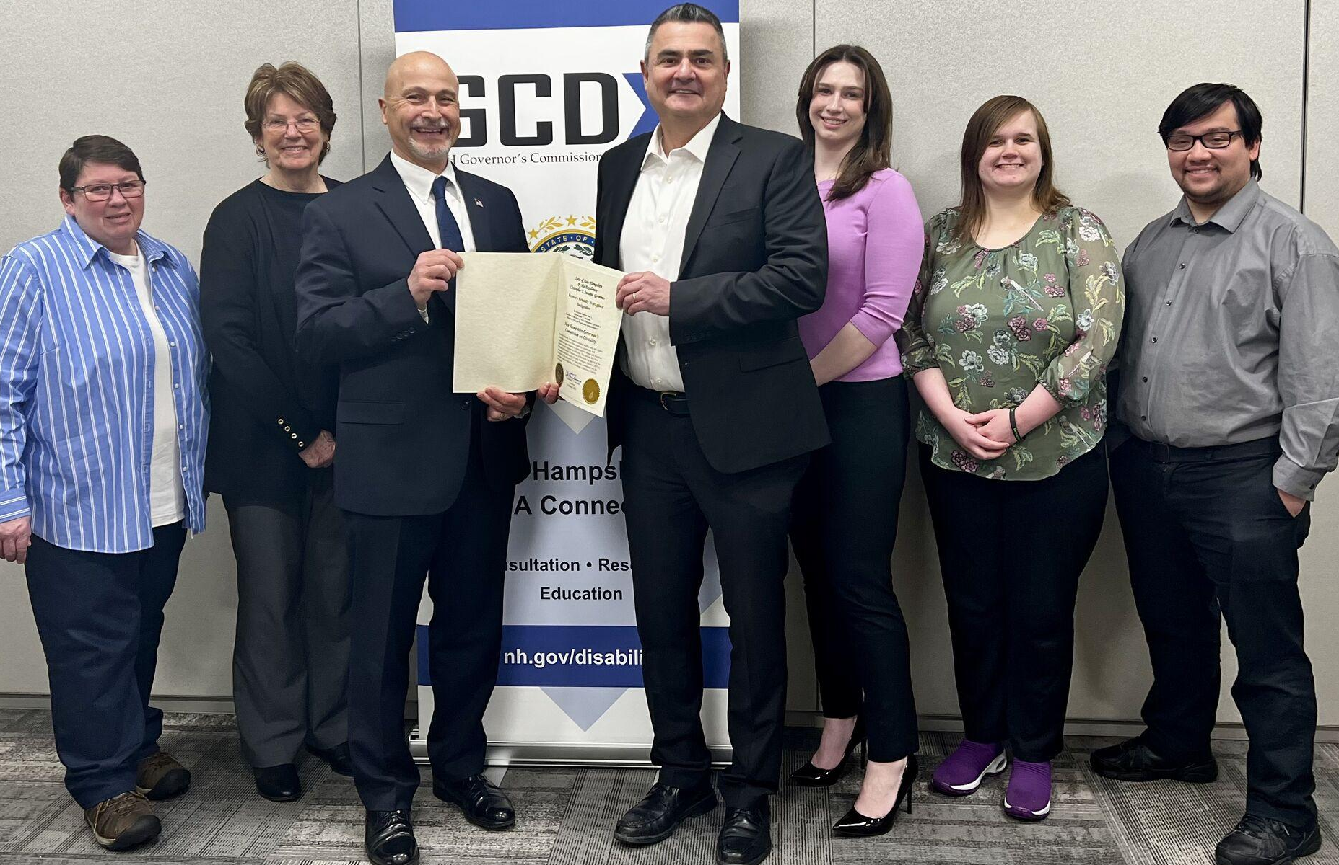
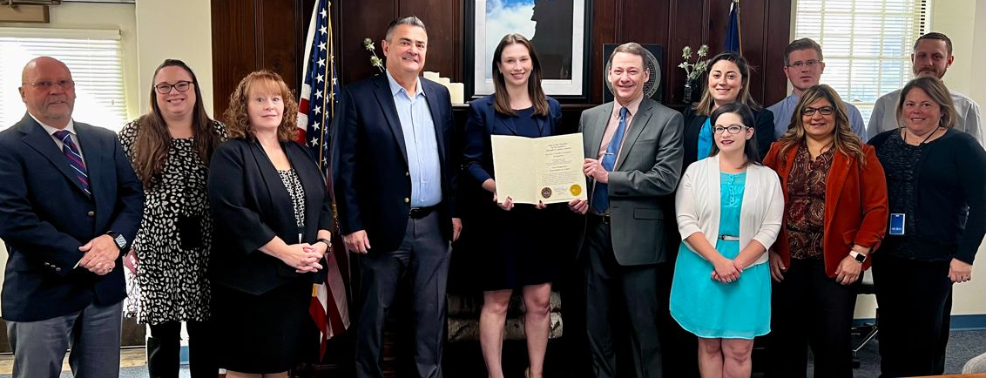
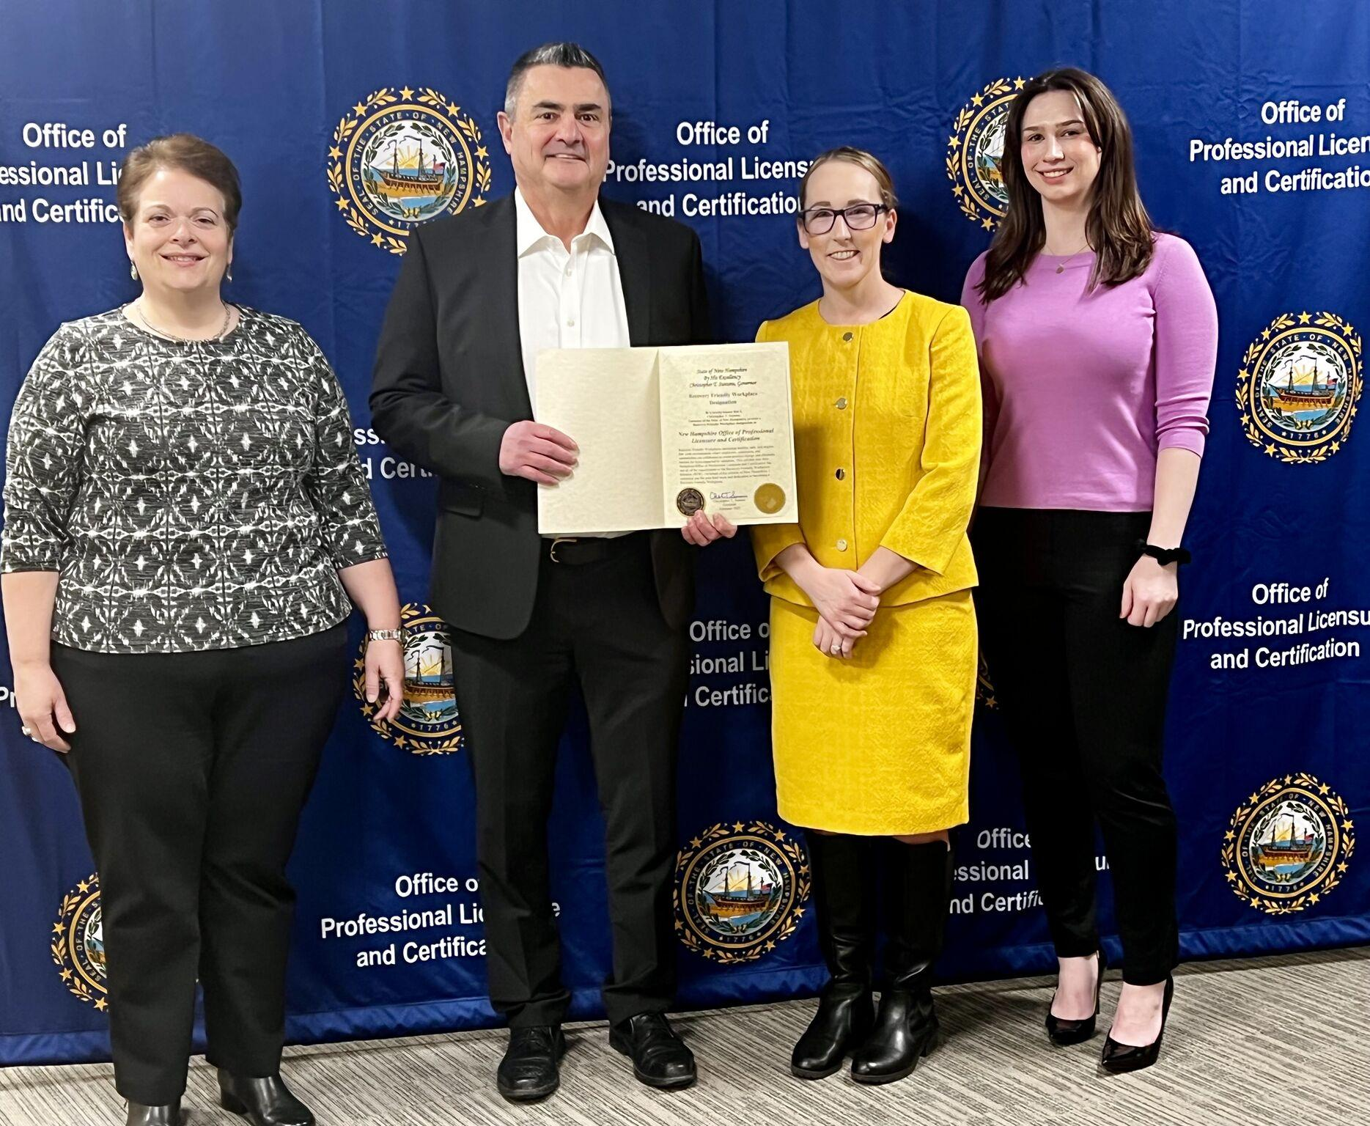
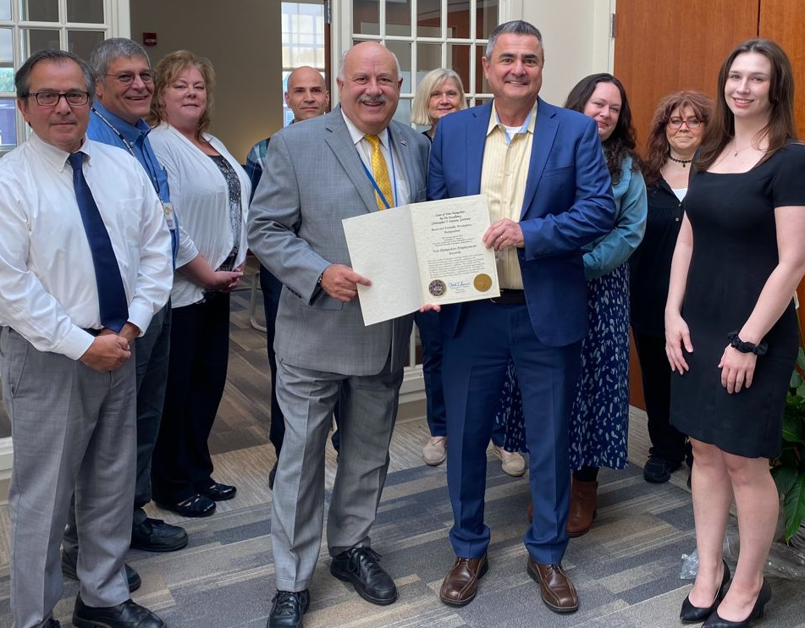
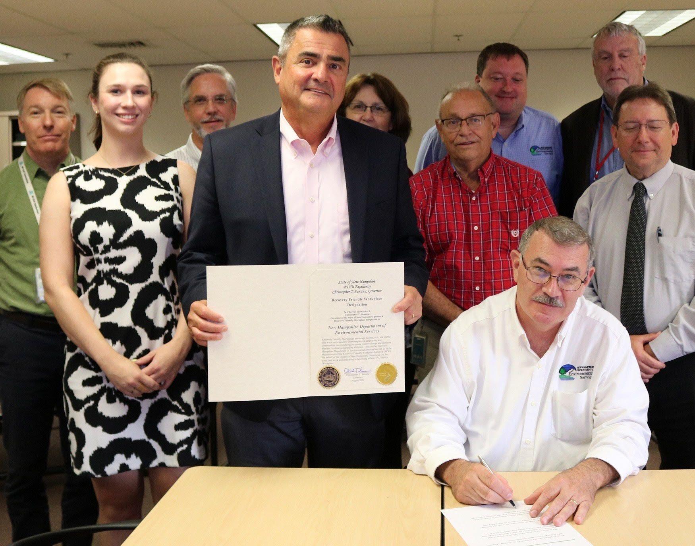
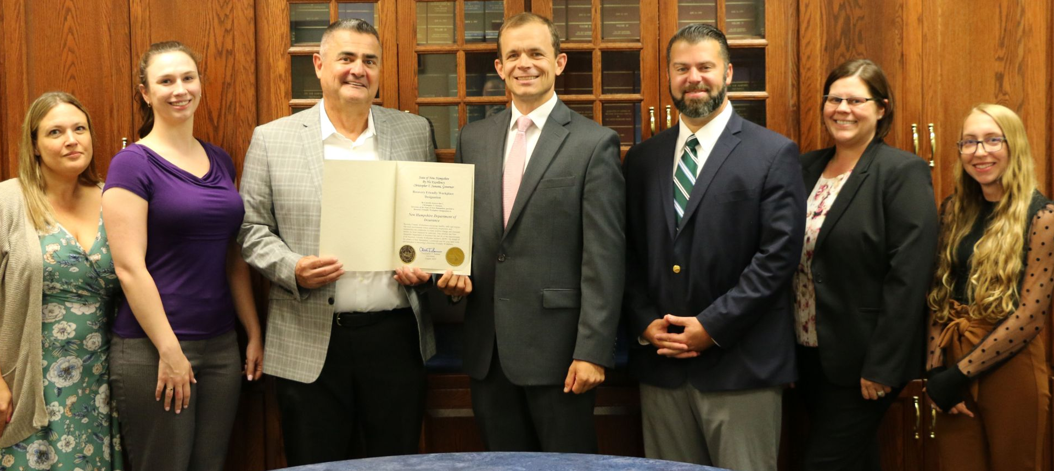

Slide 9
Contact Information
Kristie Curtis
Recovery Friendly Advisor
kristie@recoveryfriendlyworkplace.com
@RFW_NH
To become a Recovery Friendly Workplace or learn more:
recoveryfriendlyworkplace.com.

